Slide 1
DIGITAL PORTFOLIO
STUDENT NAME: S.RAMYA
REGISTER NO AND NMID: 2422K0189 AND asbru3124cs06
DEPARTMENT: B.SC(CS)
COLLEGE: COLLEGE/ UNIVERSITY:CHERRAAN`S ARTS SCIENCE COLLEGE

Slide 2
PROJECT TITLE
Career Compass A Skill Tracker for Students

Slide 3
Agenda
1.Problem statement
2.Project overview
3.End users
4.Tools and technologies
5.Portfolio design and layout
6.Features and Functionality
7.Results and Screenshots
8.conclusion
9.Github link

Slide 4
🎯 1: Problem Statement
Problem StatementWhy Career Compass? - Students often lose track of skills and certifications - Lack of clarity during job applications and interviews - No centralized tool to visualize career progress---💡
Notes:
Problem StatementWhy Career Compass? - Students often lose track of skills and certifications - Lack of clarity during job applications and interviews - No centralized tool to visualize career progress---💡

Slide 5


💡 2: Project Overview
What is Career Compass? - A personal dashboard for students - Tracks skills, certifications, and goals - Helps build confidence and readiness for careers
3/21/2024 Annual Review

Slide 6

👥 3: End Users
Who Benefits? - College students - Job seekers - Career counselors and mentors

Slide 7

🧰 4: Tools And Technologies
Tech Stack | Technology | Role ||------------|------|| HTML | Structure || CSS | Styling || JavaScript | Interactivity || LocalStorage | Data persistence |

Slide 8

🎨 5.Portfolio design and layout
User Interface - Clean, card-based layout - Responsive design for mobile and desktop - Progress bars and motivational elements

Slide 9

⚙️ 6. Features and Functionality
Functionality - Add/edit/delete skills - Set and track career goals - Export summary for resumes - Visual progress indicators

Slide 10
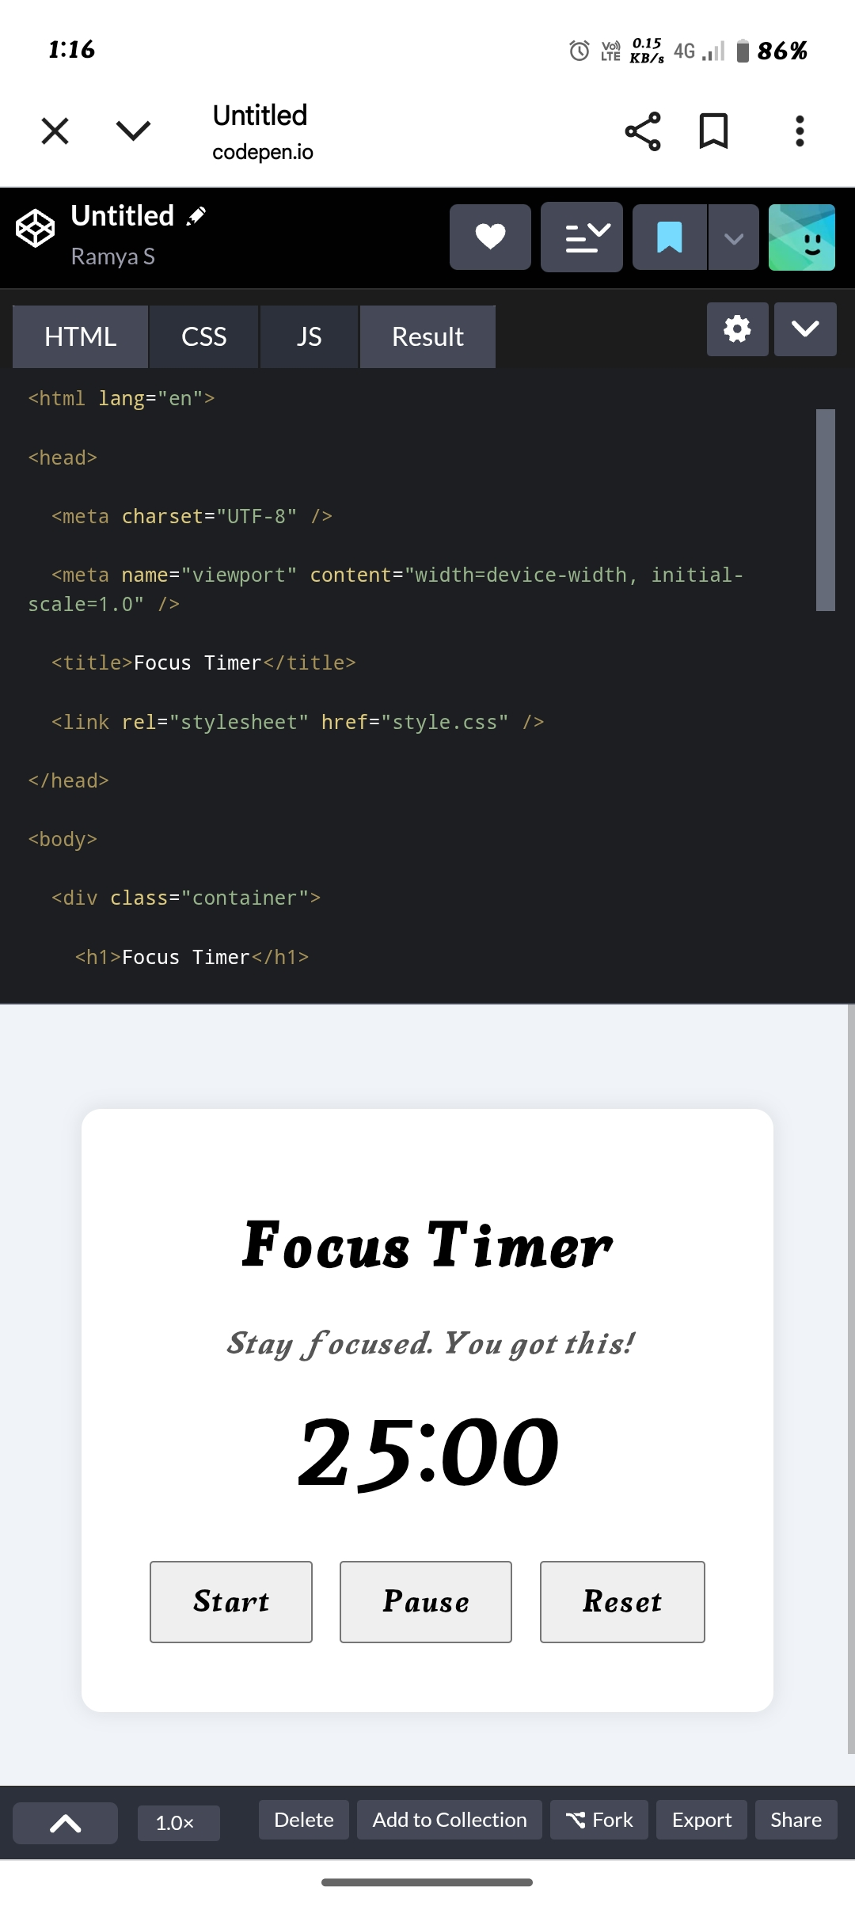
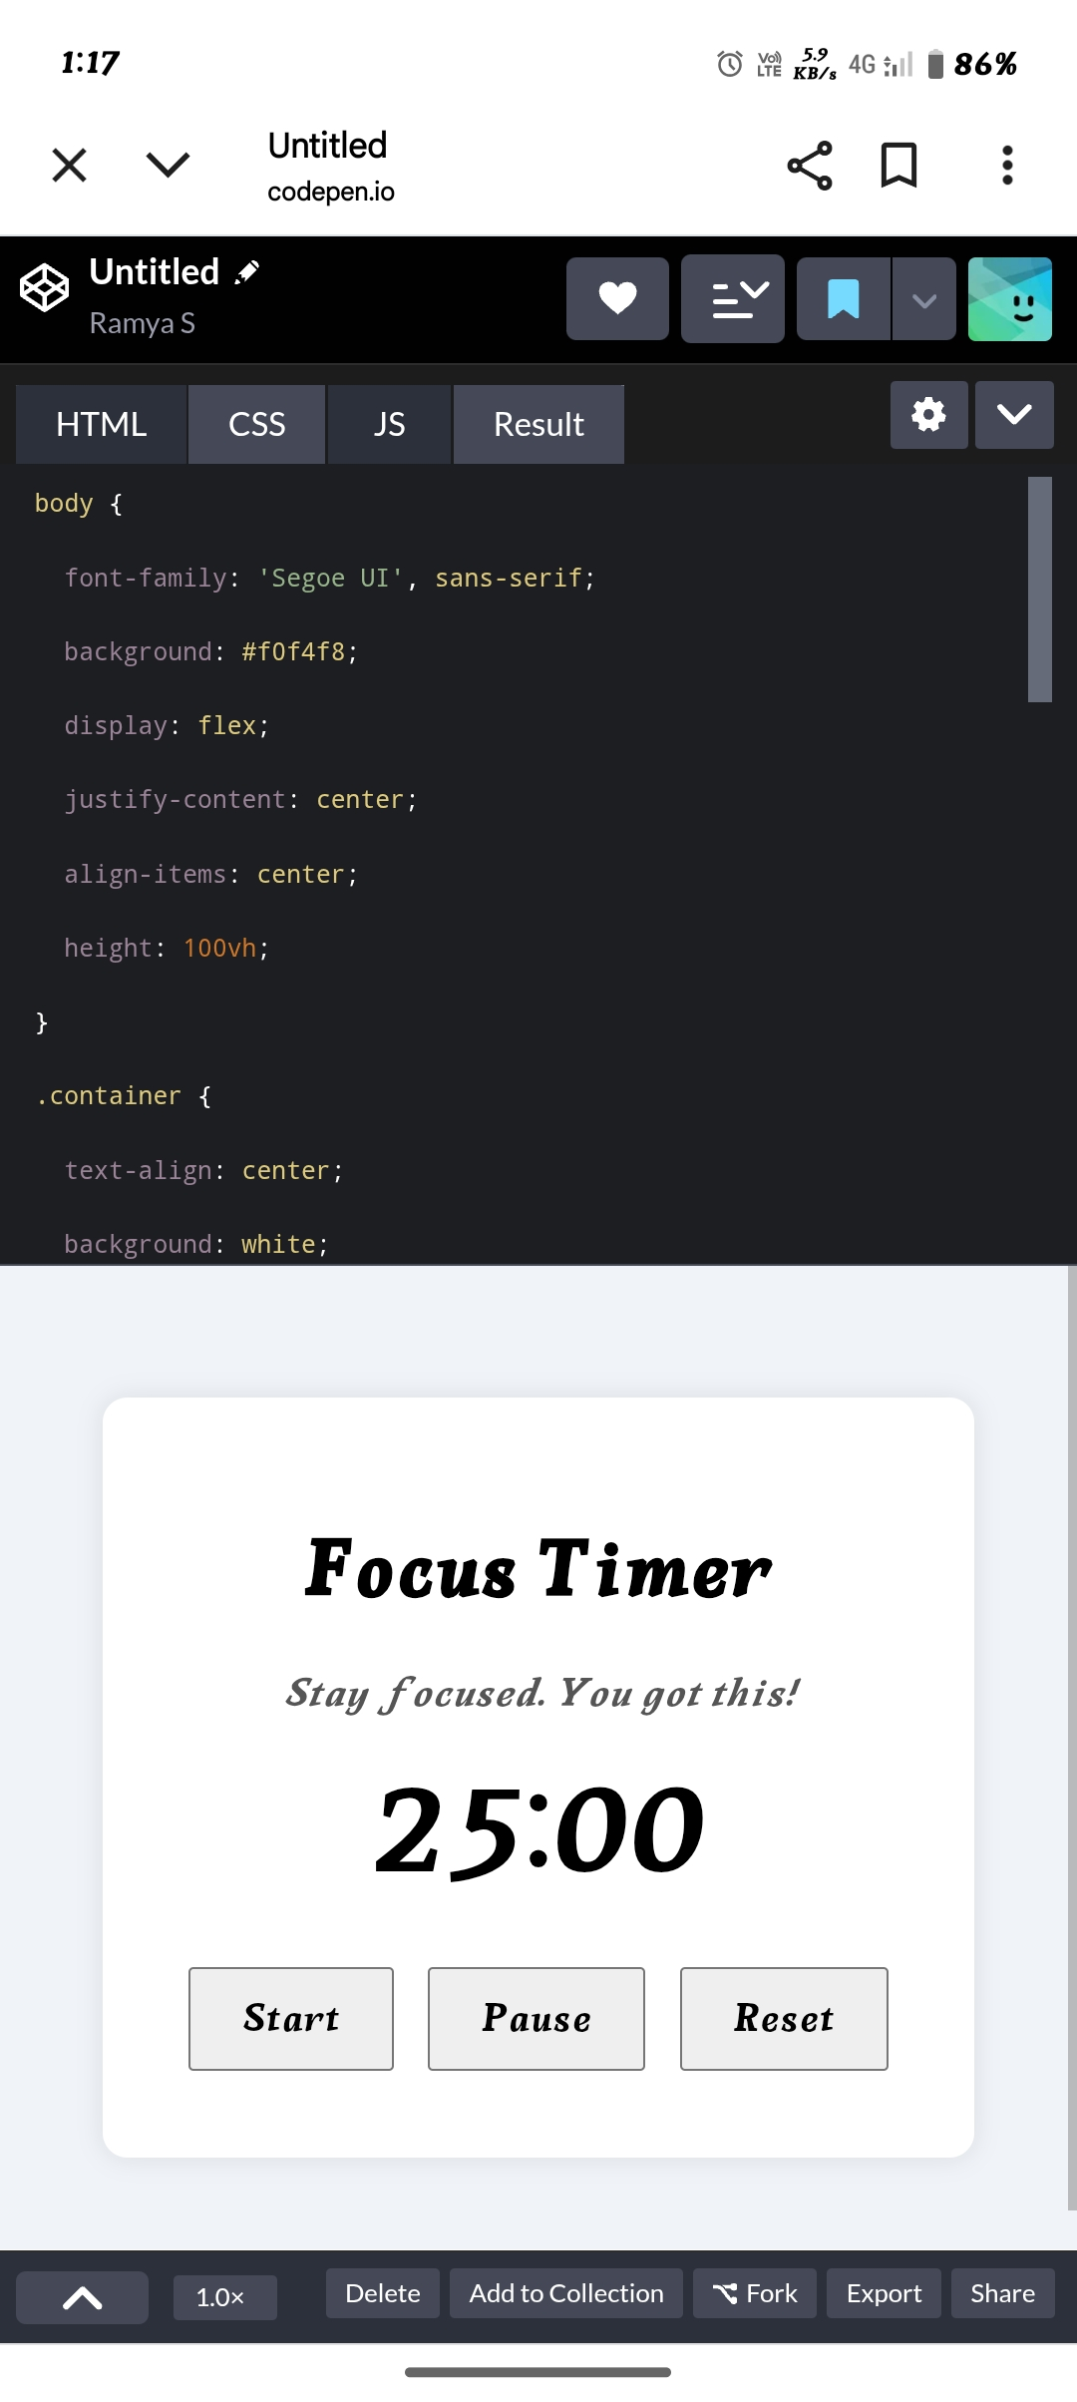
📸 7.Results and screenshots
📸 Slide 8: Sample Dashboard
10

Slide 11
8.CONCLUSION
Impact Career Compass empowers students to take charge of their growth, build confidence, and showcase their achievements effectively.
11

Slide 12
9.GitHub link
https://github.com/ramyas88255-bit/Ramya Web Development.git

